Slide 1
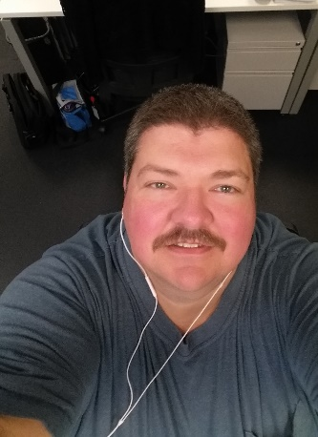
Jon Hatfield - Professional Development Plan
 |  | Name: |  |  | Jon Hatfield
 |  | Job Title: |  |  | Software Developer
 |  | Years in Position: |  |  | < 1 year
 |  | Supervisor: |  |  | Dennis Middleton
 |  | Date of Employment: |  |  | 6/11/2018
Experience
Time Spent | Title |  | Company |  |  |  | Location
Present | Software Developer |  | TCC |  |  |  | Carmel
< 1 year | Web Developer |  | Stratice Healthcare, Inc. |  |  |  | Carmel
< 1 year | Software Engineer |  | Salesforce Marketing Cloud, Inc. |  |  |  | Indianapolis
4 years | Software Engineer |  | Interactive Intelligence, Inc. |  |  |  | Indianapolis
1 year | Java Software Engineer |  | SearchSoft Solutions, Inc. |  |  |  | Indianapolis
Education: College / Degree(s) BS – Computer and Information Science – IUPUI 2011 BS – Applied Mathematics – IUPUI 2011 AS – Computer and Information Technology – IUPUI 2009
Certification/ Training / Memberships |  |  |  | Hobbies/ Interests |  | My family, Technical Reading, Audiobooks, Minecraft, Politics, Cooking Outdoors, Physics, Higher Mathematics
Short Term Career Goals:
Help the team become more effective at our tasks by sharing knowledge, promoting learning opportunities, and implementing best practices. Improve the codebase by refactoring and increased test coverage. Learn anything I can to be more valuable and effective in my current role.
1-2 years: Promotion to Senior Software Developer at TCC do to my demonstrated effectiveness developing in Filis and obvious wide-ranging knowledge of software development. Upgrade our POS frontend to the current version of Angular.
Long Term Career Goals:
3-5 years: Senior Software Developer or higher position at TCC, possibly a leadership role, as long as I still spend most of my time writing software and helping others to do so.
Strengths:
Able to consume vast amounts of information (drinking from the fire hose), Learning new technologies and quickly becoming effective with them, Strong work ethic, Critical Thinking, Self Motivated, Willing to spend as much time as necessary at work and otherwise to learn what I need to excel at my work
Areas of Improvement:
Small talk and interpersonal relations, Talking to non-developers, More experience with front end development
Development Plan: (12-18 mos. Action Plan)
Action | Assistance Needed | Status
Learn Oracle ATG | Yes | In progress
More experience with AngularJS | None | In progress
Participate in TCC “Culture of Good” events | ? | In progress

